Slide 1
Frameworks, Algorithms, and Systems for Efficient Discovery of Data-backed Facts
Gensheng Zhang
Notes:
Hi everyone, thank you for attending. The title of my dissertation is frameworks, algorithms, and system for efficient discovery of data-backed facts.

Slide 2
Overview
Exceptional Facts
Prominent Streaks
Fact Watcher
ClaimBuster
Maverick
Notes:
In the first part of this presentation, I will talk about two fact-finding frameworks. One for finding exceptional facts about entities in knowledge graphs, and the other for finding prominent streaks in time-series data.
In this second part, I will present three fact-finding and fact-checking systems, which are Fact Watcher, ClaimBuster, and Maverick. These systems discover data-backed facts and provide means of verifying factual claims.

Slide 3
Publications
Gensheng Zhang, Xiao Jiang, Ping Luo, Min Wang, and Chengkai Li. 2014. Discovering General Prominent Streaks in Sequence Data. ACM Trans. Knowl. Discov. Data 8, 2, Article 9 (June 2014), 37 pages.
Naeemul Hassan, Afroza Sultana, You Wu, Gensheng Zhang, Chengkai Li, Jun Yang, and Cong Yu. 2014. Data in, fact out: automated monitoring of facts by FactWatcher. Proc. VLDB Endow. 7, 13 (August 2014), 1557-1560.
Gensheng Zhang, and Chengkai Li. 2018 Maverick: Discover Exceptional Facts from Knowledge Graphs. Proc. SIGMOD 2018. (submitted)
Naeemul Hassan, Gensheng Zhang, Fatma Arslan, Josue Caraballo, Damian Jimenez, Siddhant Gawsane, Shohedul Hasan, Minumol Joseph, Aaditya Kulkarni, Anil Kumar Nayak, Vikas Sable, Chengkai Li, and Mark Tremayne. 2017 ClaimBuster: The First-ever End-to-end Fact-checking System. Proc. VLDB Endow. (August 2017)
Brett Walenz, You Will Wu, Seokhyun Alex Song, Emre Sonmez, Eric Wu, Kevin Wu, Pankaj K Agarwal, Jun Yang, Naeemul Hassan, Afroza Sultana, Gensheng Zhang, Chengkai Li, Cong Yu. 2014. Finding, Monitoring, and Checking Claims Computationally Based on Structured Data. Computation+Journalism Symposium ( October 2014)
Abolfazl Asudeh, Gensheng Zhang, Naeemul Hassan, Chengkai Li, and Gergely V. Zaruba. 2015. Crowdsourcing Pareto-Optimal Object Finding By Pairwise Comparisons. In Proceedings of the 24th ACM International on Conference on Information and Knowledge Management (CIKM '15).

Slide 4
Maverick: Discover Exceptional Facts
from Knowledge Graphs
SIGMOD 2018 (submitted)
Notes:
In the following, I am going to present my current project, Maverick, which is a framework for discovering exceptional facts from knowledge graphs.

Slide 5

Knowledge graphs
Entity
Entity
Relationship
Notes:
A knowledge graph is a graph that records properties of and relationships between real-world entities. For example, entities can be people, books, films. Properties of an entity such as a person, can be age, profession, nationality and so on. Relationships can be, for example, friendship, authorship and so on.

Slide 6

Exceptional Facts
A fact separates an entity from many others
Notes:
Informally, an exceptional fact about an entity is a fact that separates the entity from many others.

Slide 7

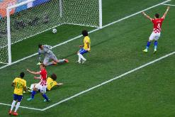



Exceptional Facts
This was Brazil's first own goal in World Cup history
Denzel Washington followed Sidney Poitier as only the second black to win the Best Actor award.
Hillary Clinton becomes first female presidential nominee.
Notes:
Let’s look at some factual statements in published news articles.
Denzel Washi….
This was Brazil’s …
Hillary Clinton …

Slide 8
Exceptional Facts
Entity of Interest
Denzel Washington
Denzel Washington followed Sidney Poitier as only the second black to win the Best Actor award.
Notes:
Let’s take a close look at the Denzel Washington’s example.
An exceptional facts consists of 3 components: entity of interest

Slide 9
Exceptional Facts
Entity of Interest
Denzel Washington
Qualifying Attributes
Denzel Washington followed Sidney Poitier as only the second black to win the Best Actor award.
Ethnicity
Notes:
The qualifying attributes

Slide 10
Exceptional Facts
Entity of Interest
Denzel Washington
Qualifying Attributes
Denzel Washington followed Sidney Poitier as only the second black to win the Best Actor award.
Ethnicity
Context
Best Actor Winners
Notes:
And the context.
In each exceptional fact, among all the entities, in the context, the entity of interest is one of the few, or even the only one that bears a particular value combination on the qualifying attributes.
In the example of Denzel Washington, we can paraphrase the facts as: Among all the best actors winners, Denzel Washington is one of the only two person whose ethnicity is African American.

Slide 11
Objective
Given
An entity in a knowledge graph
Find
A context
A set of qualifying attributes (subspace)
Goal
The entity is exceptional
- belonging to the context with many other entities
- bearing a peculiar value w.r.t the subspace
Notes:
Informally, given an entity of interest, our goal is to find a pair of context and subspace, such that the entity belongs to the context with many other entities, and it is exceptional because it bears a peculiar value with regard to subspace, comparing to other entities in the context.

Slide 12
Objective
Given
An entity in a knowledge graph
Find
A context
A set of qualifying attributes (subspace)
Goal
The entity is exceptional
- belonging to the context with many other entities
- bearing a peculiar value w.r.t the subspace
Denzel Washington
Best Actor winners
Ethnicity = African American
Notes:
For example, Denzel Washington is exceptional among best actor awardees, because he is an African American.

Slide 13
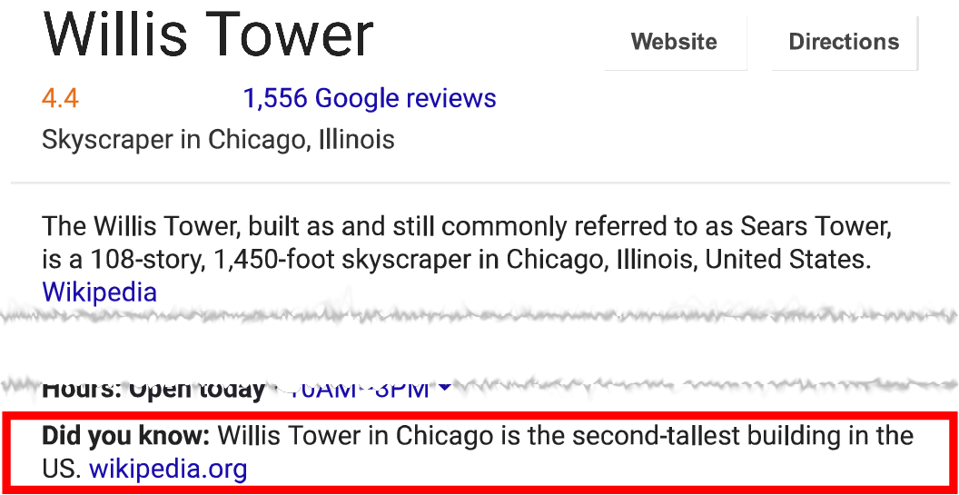
Applications
Computational Journalism
Fact-finding (Denzel Washington)
Fact-checking (Hillary Clinton)
The first female presidential nominee was Victoria Woodhull, not Hillary Clinton (snopes.com)
Recommendation Systems
Friends, news, and product promotion
Data Cleaning
Notes:
As we can see such statements all over the news articles, discovery of exceptional facts is useful to various important applications.
For example, journalists are interested in monitoring and discovering attention-seizing factual statements like Denzel Washington’s Example.
In fact-checking, fact-checkers can compare the statements made by humans with automatically discovered facts. For example, on snopes.com, there is a fact-check about whether Hillary Clinton is the first female presidential nominee or not.
Exceptional facts can help promote friends, news and product in various recommend systems. For example, search engine can promote their search results by showing exceptional facts. If you search Willis Tower on Google, you may see the “did you know” sections which tells one of its exceptional facts.
When the discovered facts are inconsistent with known truth or apparent common sense, it reveals incomplete data or data errors. Such insights aid knowledge base cleaning and completion.

Slide 14
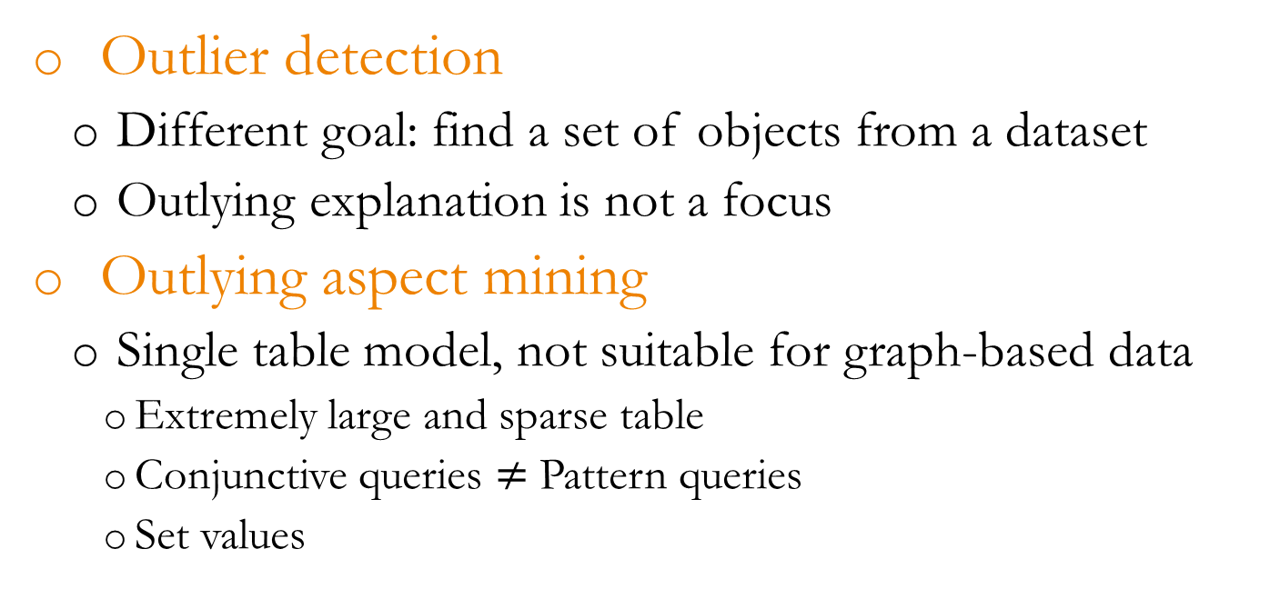
Related work
Outlier detection
Different goal: find a set of objects from a dataset
Outlying explanation is not a focus
Outlying aspect mining
Single table model, not suitable for graph-based data
Extremely large and sparse table
Conjunctive queries $≠$ Pattern queries
Set values
Notes:
There are two major areas that are related to our work: outlier detection, and outlying aspect mining.
Outlier detection is to find a set of objects from a dataset, it does not focus on explaining why outliers are outlying. While our work tries to explain why an object is exceptional by showing the pairs of contexts and subspaces where the object is highly-scored.
In general, we share the same goal with outlying aspect mining, which focuses on outlying explanation for a given object. However, existing techniques adopts a single table model, which is not suitable for graph-based data, such as knowledge graphs. First, a table that models a graph can be extremely large and sparse, given the sizes and the variety of relationships in a knowledge graph. Second, only handful methods consider contextual outlying explanation. The existing techniques model contexts using conjunctive queries. In graphs, conjunctive queries are not sufficient. Third, existing techniques do not consider set values in defining contexts. However, set values in graphs are very common.

Slide 15
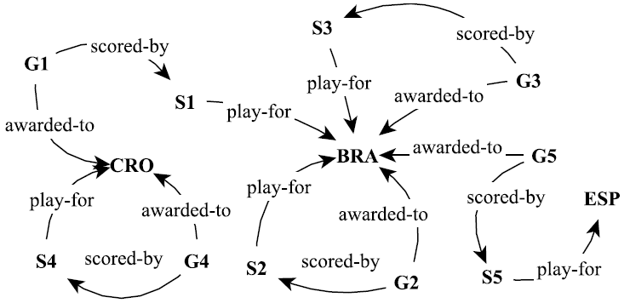

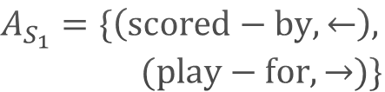
Concepts and Definitions
Attributes
Attributes: the labels of incoming/outgoing edges
Values: direct neighbors
Subspace (A)
A subset of attributes
$$A_{S_{1}}=\{\left(scored−by, ←\right),$$
$(play−for, →)\}$
$$S_{1}.A=(\left\{G_{1}\right\}, \left\{BRA\right\})$$
Notes:
In the following, I will show our formal definition of attributes, subspaces, contexts, and the exceptional fact discovery problem.
The attributes of an entity are the entity’s incoming/outgoing edge labels and the attribute values are the entity’s direct neighbors
For example, entity S1 has two attributes: score-by, play-for. The values of the two attributes are G1, BRA, respectively.
A subspace is a subset of attributes.

Slide 16


Concepts and Definitions
Context
Entities sharing some common characteristics
<Pattern, Variable> pair
P₁
<P₁, ?g>
Goals scored by
Brazilian (BRA) players
Notes:
A context is a set of entities sharing some common characteristics. We express a context by a pair of a pattern and a variable in the pattern.
For example, P1 in the figure and the variable ?g define a context which consists of goals scored by Brazilian players.

Slide 17
Concepts and Definitions
Context
Entities sharing some common characteristics
<Pattern, Variable> pair
P₁
<P₁, ?s>
Players who scored at least
one goal and play for Brazil
Notes:
Of course, pattern P1 also defines another context another variable ?s, which consists of players who scored at least one goal and play for Brazil.

Slide 18



Concepts and Definitions
Context
Entities sharing some common characteristics
<P₁, ?g>: entities in the matches of P₁ mapped to ?g
P₁
M₁
M₂
M₃
Notes:
Formally, a match to a pattern is a subgraph of the knowledge graph. And the subgraph is edge isomorphic to the pattern.
a context defined by a pattern and a variable is the set of entities that are mapped to the variable.

Slide 19
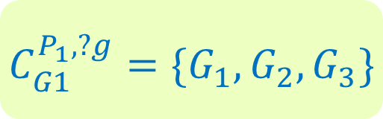
Concepts and Definitions
Context
Entities sharing some common characteristics
Patterns
P₁
M₁
$$C_{G1}^{P_{1}, ?g}=\{G_{1},G_{2},G_{3}\}$$
M₂
M₃
Notes:
As a result, the context defined by P1 and variable ?g is the set, G1, G2, G3.
If an entities appears in the set, we say the pattern and the variable define a context of the entity. For example, P1 and variable ?g define a context of G1.

Slide 20
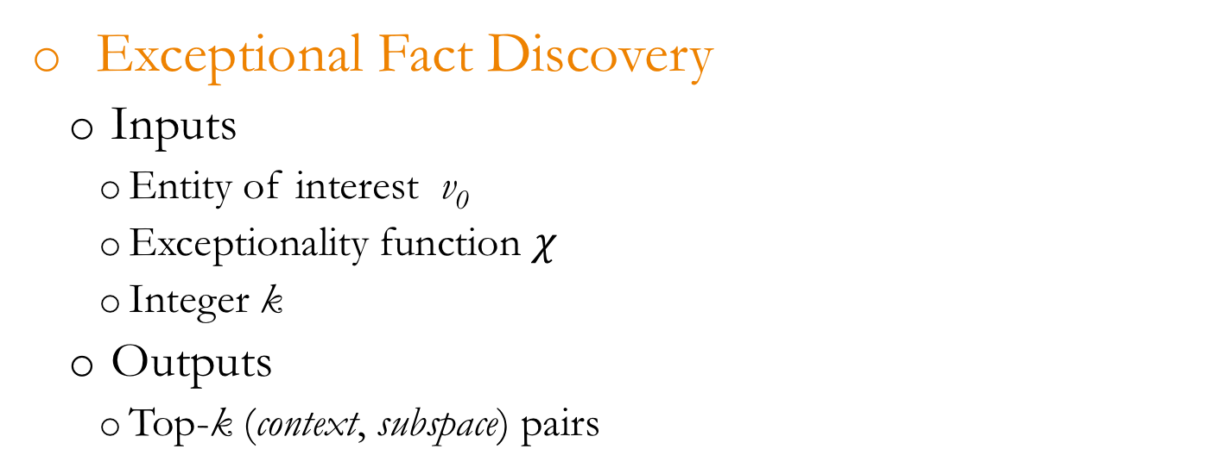
Problem Formulation
Exceptional Fact Discovery
Inputs
Entity of interest v₀
Exceptionality function $χ$
Integer k
Outputs
Top-k (context, subspace) pairs
Notes:
We now are ready to define the problem of exceptional fact discovery.
Given an entity in the knowledge, an exceptionality function chi, and an integer k, the objective of exceptional fact discovery is to find top-k highest scored context-subspace pairs.

Slide 21


Problem Formulation
Exceptional Fact Discovery
Inputs
Entity of interest v₀
Exceptionality function $χ$
Integer k
Outputs
Top-k (context, subspace) pairs
Entity : G1
Context : $C_{G1}^{P_{1}, ?g}$
Subspace : {(awarded-to, $→$)})
P₁
Among all the goals scored by
BRA players, G1 is the only
own goal.
Notes:
For example, given entity G1, we may find that the pair as shown is exceptional, given that G1 is the only own goal among all the goals in the context.

Slide 22
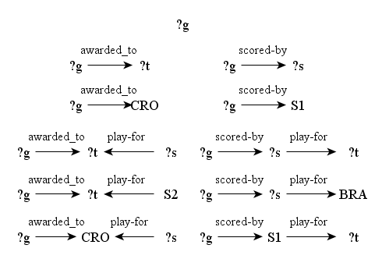

Challenges
Space of attributes: $O(2^{|A_{v_{0}}|})$
Space of patterns: $Ω(2^{|V_{G}|})$
{}
{gender}
{ethnicity}
{profession}
{gender, ethnicity}
{gender, profession}
{ethnicity, profession}
{gender, ethnicity, profession}
Notes:
The main computational challenge of the problem is that we have to explore two extremely large search spaces, one of subspaces, one of patterns. It is challenging to prune subspaces and patterns, because the exceptionality scores usually do not have anti-monotone property.

Slide 23
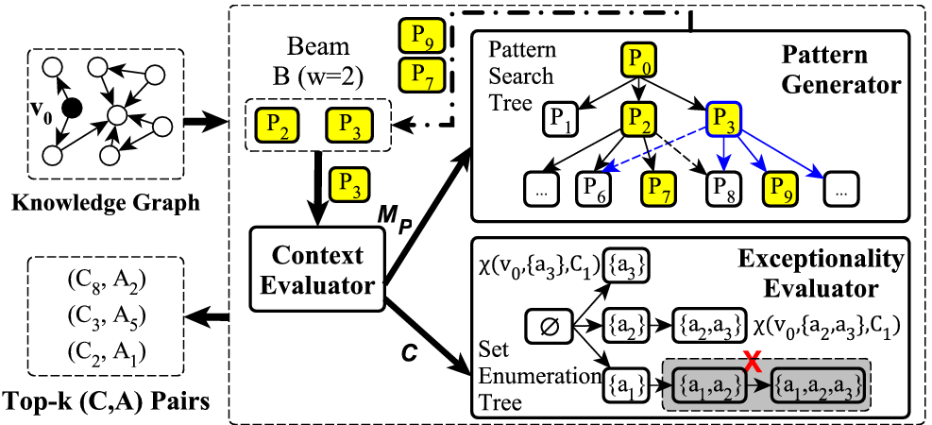
Maverick
Notes:
We, then, propose a beam search based framework, Maverick, to discover exceptional facts about entities.
The search is accomplished mainly by three components: context-evaluator, exceptionality evaluator, and pattern generator.
Maverick maintains a beam, which is a fixed-size priority queue,
For each pattern in the beam, context evaluator evaluates the pattern to obtain its matches and contexts.
w.r.t each context, the exceptionality evaluator evaluates the degree of exceptionality of the entity, and outputs top-k context-subspace pairs
Pattern generator then finds all the children of the current pattern. Basically, it maintains a tree of pattern, which we call pattern search tree. The top children in each level will become the new beam at next iteration.

Slide 24
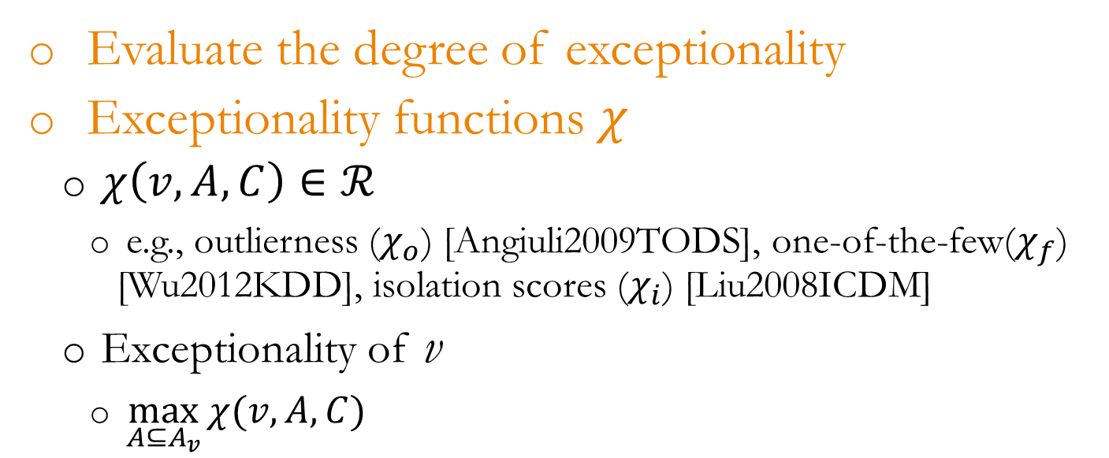
Exceptionality Evaluator (EE)
Evaluate the degree of exceptionality
Exceptionality functions $χ$
$χ\left(v, A, C\right)∈ℛ$
e.g., outlierness ($χ_{o}$) [Angiuli2009TODS], one-of-the-few($χ_{f}$) [Wu2012KDD], isolation scores ($χ_{i}$) [Liu2008ICDM]
Exceptionality of v
$\max_{A⊆A_{v}}{χ(v, A, C)}$
Notes:
As mentioned previously, the exceptionality evaluator is responsible for evaluating the given entity’s degree of exceptionality, with regard to a given context.
An exceptionality function is a real function, and the inputs of the function are an entity, a subspace and a context.
Note that Maverick allows users to use any outlyingness/interestingness functions based on their applications. For example, one can use outlierness, or one-of-the-few, or isolation scores, and many others.
The exceptionality of an entity is the highest exceptionality score among all the subspaces

Slide 25
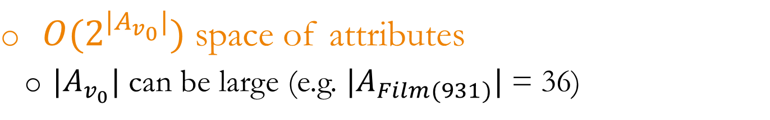
Exceptionality Evaluator (EE)
$O(2^{|A_{v_{0}}|})$ space of attributes
$|A_{v_{0}}|$ can be large (e.g. $|A_{Film(931)}|$= 36)
{}
{gender}
{ethnicity}
{profession}
{gender, ethnicity}
{gender, profession}
{ethnicity, profession}
{gender, ethnicity, profession}
Notes:
As discussed before, the space of attributes is exponentially large. For example, we have entities in our graph that have more than 40 properties.

Slide 26
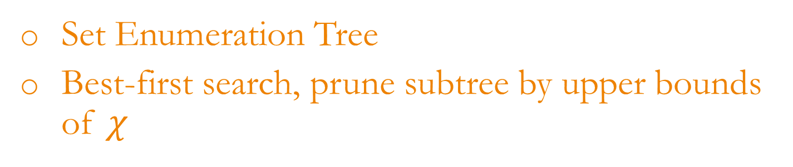
Exceptionality Evaluator (EE)
Set Enumeration Tree
Best-first search, prune subtree by upper bounds of $χ$
{}
{gender}
{ethnicity}
{profession}
{gender, ethnicity}
{gender, profession}
{ethnicity, profession}
{gender, ethnicity, profession}
Notes:
To tackle the challenge, we first organize all the possible subspaces as a set enumeration tree, and apply best-first search method on the tree, with the upper bound of exceptionality as the heuristics. A subtree will be pruned if the upper bound of its root is less than a threshold or the minimum of the current top-k scores.

Slide 27


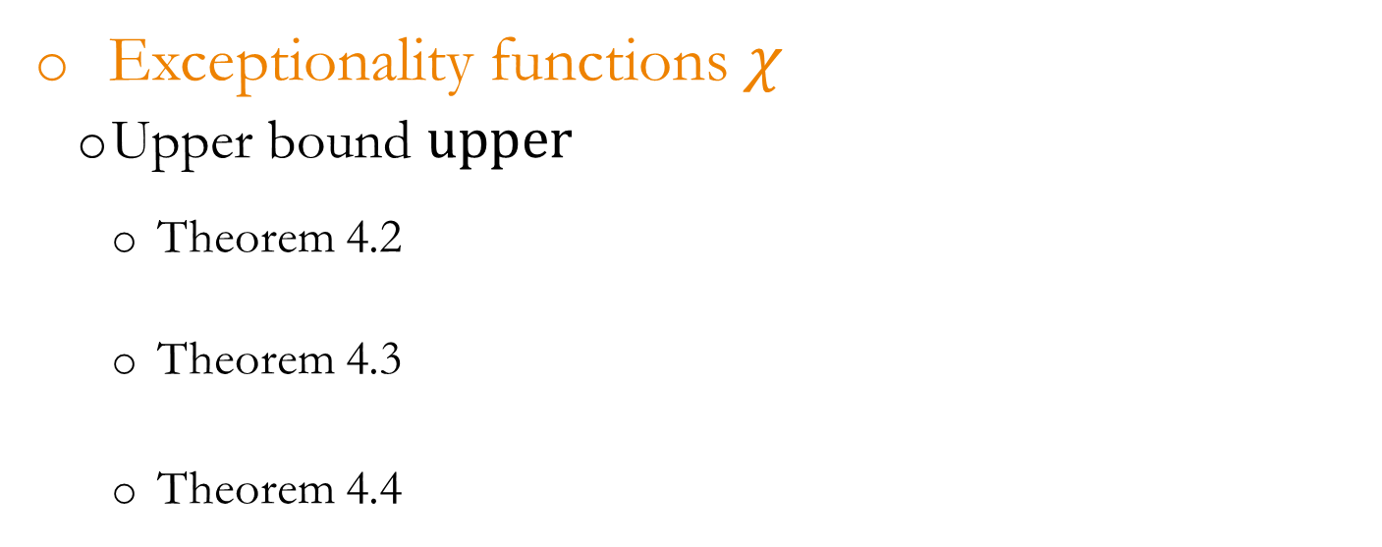
Exceptionality Evaluator (EE)
Exceptionality functions $χ$
Upper bound $upper$
Theorem 4.2
Theorem 4.3
Theorem 4.4
Notes:
In order to illustrate how maverick works, for each exceptionality function used in this work, we’ve derived their upper bounds.

Slide 28
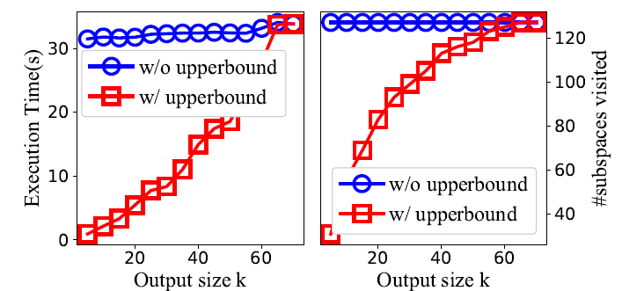
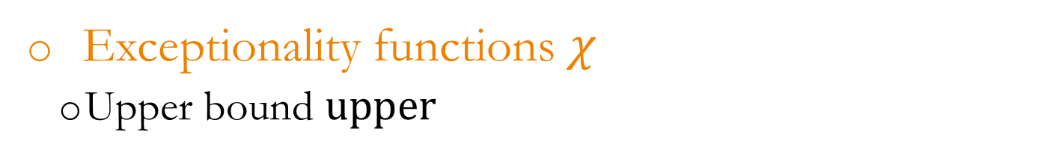
Exceptionality Evaluator (EE)
Exceptionality functions $χ$
Upper bound $upper$
Notes:
Although, in the many cases, the upper bound may be loose. In practice, upper bounds help significantly reduce the execution time since it prunes the number of subspaces substantially, as shown in the figure.

Slide 29
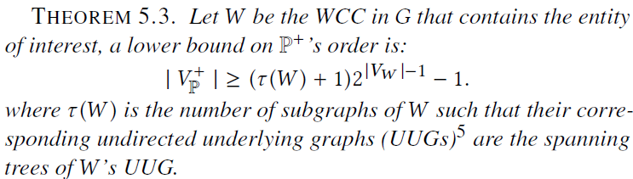

Pattern Generator (PG)
Finds candidate patterns
Space of patterns: $Ω(2^{|V_{G}|})$
Notes:
In the following, I will take about the component Pattern Generator, which is responsible for finding candidate patterns. We show that the space of patterns is exponentially large with regard to the order of the knowledge graph.

Slide 30
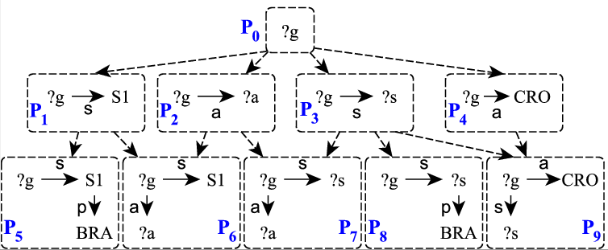

Pattern Generator (PG)
Space of patterns: $Ω(2^{|V_{G}|})$
Notes:
Conceptually, Maverick organizes search space of patterns as a partial order based on the subsumption relation on patterns.
In the partial order, each child of a pattern is an immediate super graph of the pattern.
For example, in the graph of patterns as shown, both P5 and P6 are super-graph and thus, children of P1.

Slide 31



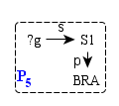


Pattern Generator (PG)
Parent – child relationship
Parent
e
Child
e:
Type 7
Notes:
In other words, a child has one and exactly one more edge than its parent.
The extra edge that a child can be one of the 7 types as shown. For example, Adding a type 7 edge to pattern P1 may become P5, which is a child of P1.

Slide 32




Pattern Generator (PG)
Valid patterns
Relevant Pattern
A pattern must be relevant to $v_{0}$
$$∃x∈X_{P}, v_{0}∈R_{P}^{x}$$
P
P’
Notes:
However, not all patterns are useful to us. We are only interested in valid patterns. To be a valid pattern, a pattern must be relevant, which means that it has to define some context of the entity of interest. For example, let G1 be the entity of interest, P is relevant, but P’ is not, since G1 is not scored by someone who plays for CRO.

Slide 33


Pattern Generator (PG)
Valid patterns
Parent
e
Child
e:
Entity-entity link does not change mappings
P
P’
Notes:
The second criteria to be a valid patterns is that, a pattern should not have entity-entity links. Although having such links does not make the pattern semantically wrong, the reason why we exclude them is that such links do not change mappings. For example, to the problem of exceptional fact discovery, P is equivalent to P’, since every node in P’ has the same mapping as the corresponding node in P.

Slide 34
Pattern Generator (PG)
Construct Partial Order of Valid Patterns
Pattern-based Pattern Generation (Parent → Child)
Add all possible edges and check if valid
Expensive validation: needs pattern evaluation
Exponential number of patterns
Pattern evaluation is expensive on large graphs
Notes:
In order to construct the partial order of valid patterns, one way is to find all the children of a given pattern.
One approach for find children of a pattern is to add all possible edges, and check if the resulting patterns are valid.
However, the validation process could be very expensive. For one, there are too many patterns. For two, each pattern may be expensive the evaluate. This is true, especially when the graph is large.

Slide 35
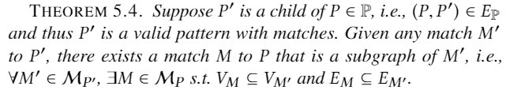
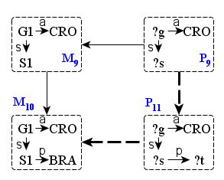
Pattern Generator (PG)
Construct Partial Order of Valid Patterns
Notes:
However, one may realize that, while every pattern is a super graph of its parent, every match to the pattern is also a super graph of a match to the parent pattern.
For example, P11 is a child of P9, so its match M10 must be a super graph of a match to P9, for example M9.

Slide 36
Pattern Generator (PG)
Construct Partial Order of Valid Patterns
Match-based Pattern Generation
Based on the evaluation results of parent pattern
Guarantee to only generate valid children
No need to validate child patterns by pattern evaluation
Notes:
It inspires us to propose a Match-based pattern generation method. Such a method is based on the evaluation results of the parent pattern. One of its major advantages comparing to pattern-based approach is that there is no need to validate child patterns, since it only generates valid patterns.

Slide 37
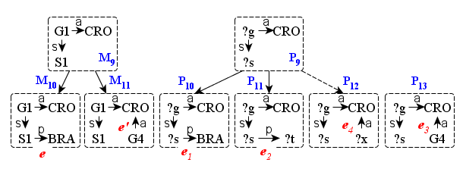
Pattern Generator (PG)
Construct Partial Order of Valid Patterns
Match → Pattern
Notes:
For example, let say we want to find children of P9, M9 is a match of P9, and there are two super graph of M9 in the knowledge graph.
E, and e’ are the extra edges in the super graphs. We then generates three children of P9 based on the two new edges, e and e’, which are p10, p11, and p12. It is easy to see the all the three patterns are valid, since they all define some context of G1. We can avoid generating invalid pattern P13 since we know e3 is an entity to entity link, which makes P13 invalid.

Slide 38
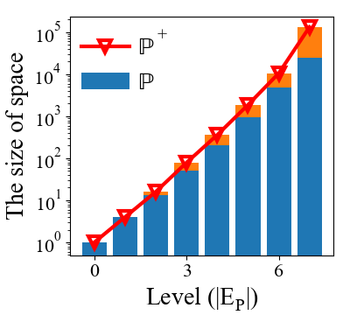
Pattern Generator (PG)
Size of the space
P⁺: Relevant patterns
P: Valid patterns
Exponential!!
Notes:
As mentioned previously, the size of the space is exponentially large. As shown in the figure, the number of patterns grows exponentially as the size of pattern grows.

Slide 39



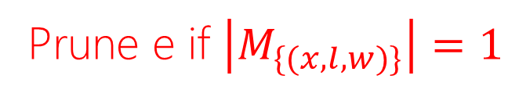
Pattern Generator (PG)
Size of the space
Singleton Pattern [Extension: Pruning Heuristic]
Parent
e
Child
e:
Prune e if $\left|M_{\{(x, l, w)\}}\right|=1$
P1
P2
P3
Notes:
To alleviate the problem, we propose a pruning heuristic to reduce the size of space, which we call singleton pattern pruning. Specifically, we want to prune a parent-child relationship in the space, if the child has an extra type 3 edge, and the edge pattern only has a single match.
Type 3 edge is a type of edges that connecting an existing variable, for example $x$, in the patter, to a new constant node w. If an edge of type 3 has only one match, which variable x is mapped to only one value. It is equivalent to have a pattern that replace the variable with the value itself.
For example, P2 is a child of P1, with an extra edge of type 3, since S1 only plays for BRA, it is equivalent to P3.

Slide 40
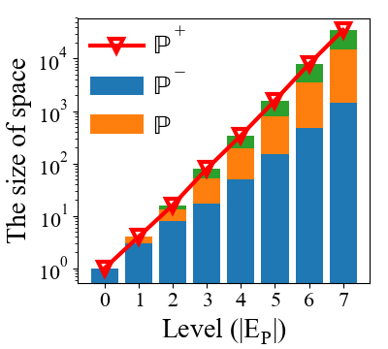
Pattern Generator (PG)
Size of the space
P⁺: Relevant patterns
P: Valid patterns
P⁻: Valid pattern
- Singleton
Still Exponential!!

Slide 41
Pattern Generator (PG)
Exponential large space
Beam Search: Only visit a fixed number of children at each level
Optimistic
Convergent
Notes:
As a result, we propose a beam search algorithm for exceptional fact discovery, since beam search only visit a fixed number of children at each level. To guide beam search, we propose two heuristics.

Slide 42


Pattern Generator (PG)
Exponential large space
Beam Search
Optimistic
$$∝|C|$$
Notes:
The first heuristics is what we call optimistic heuristic. It basically calculates the upper bound of the pattern.
The intuition is simple. We want to include the patterns that have the highest potential.
However, since the upper bound is often loose and thus the heuristic is usually proportional to the size of the context, as we can see from the experiment results later, such heuristics may not work well in practice.

Slide 43
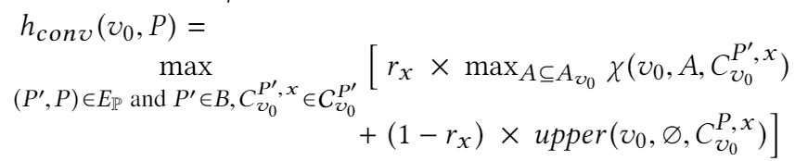
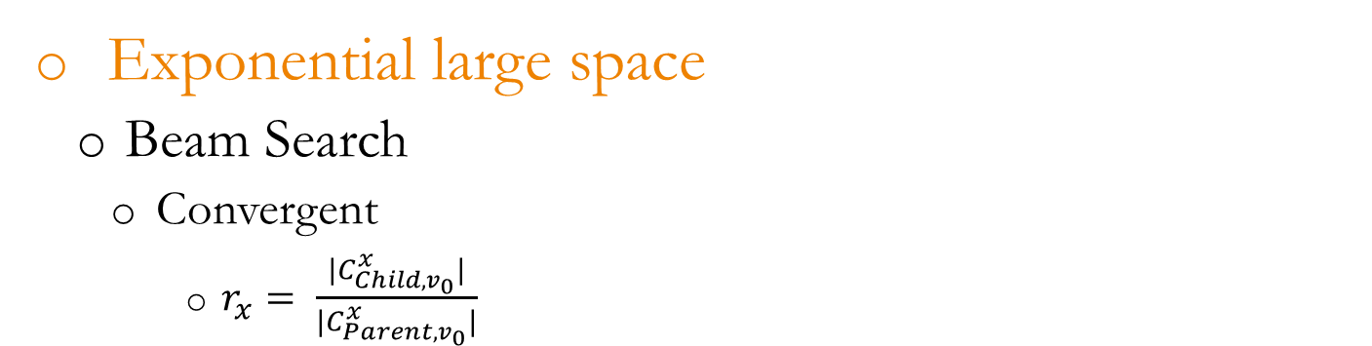
Pattern Generator (PG)
Exponential large space
Beam Search
Convergent
$r_{x}= \frac{|C_{Child, v_{0}}^{x}|}{|C_{Parent, v_{0}}^{x}|}$
Exceptionality in
parent pattern P’
Upper bound of child pattern
Notes:
The convergent heuristic is based on the observation that, if two patterns define similar contexts, then the entity of interest often has similar degree of exceptionality in the contexts defined by the patterns.
Basically, the convergent heuristic is the weighted sum of the exceptionality of the entity with regard to the parent and the upper bound with regard to the child pattern.
The weight is the ratio of the sizes of the contexts defined by the parent pattern and the child pattern.
Such design let the heuristic to be close to the scores of the parent, if the child and the parent define similar context, while to be close to the upper bound of the child, if the child define different contexts.
The benefits of doing so is that we can exclude early the patterns defining similar context that have only low scored pairs.

Slide 44
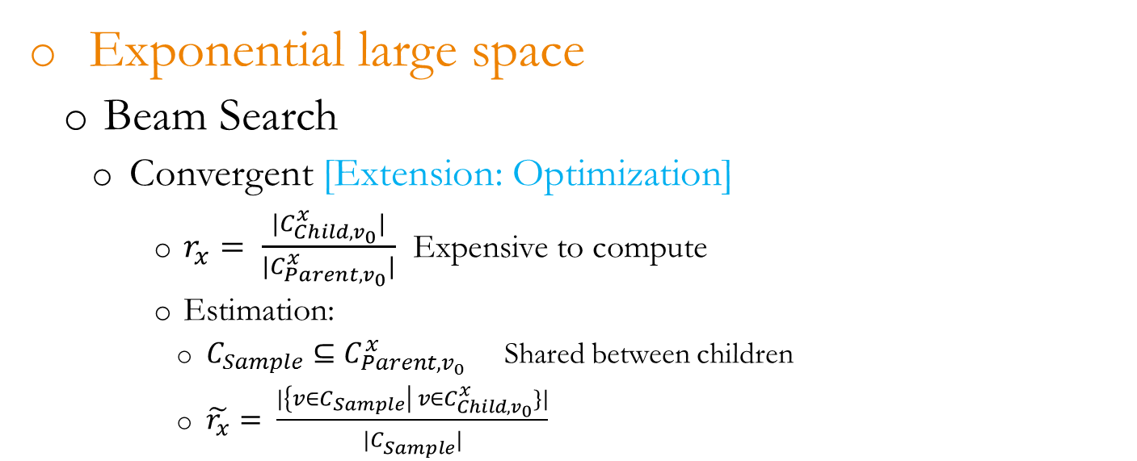
Pattern Generator (PG)
Exponential large space
Beam Search
Convergent [Extension: Optimization]
$r_{x}= \frac{|C_{Child, v_{0}}^{x}|}{|C_{Parent, v_{0}}^{x}|}$ Expensive to compute
Estimation:
$C_{Sample}⊆C_{Parent, v_{0}}^{x}$ Shared between children
$\tilde{r_{x}}= \frac{|{\left\{v∈C_{Sample}\right| v∈C}_{Child, v_{0}}^{x}\}|}{|C_{Sample}^{}|}$
Notes:
Such estimation can be implemented efficiently, for two reasons:
First, the size of the sample can be much smaller than the size of the parent context, while we can still have a very high confident level
Second, the graph engine can pick more query plans when a list of starting nodes are provided, since the graph engine is good at navigational search.

Slide 45
Experiments
Datasets
WCGoals
Created based on FIFA.com
10 11 node types, 11 13 edge types
6,980 49,078 nodes, 15,948 158,114 edges
OscarWinners Film-Award
A subgraph of Freebase
13 95 node types, 24 117 edge types
42,148 5,437,628 nodes, 63,187 10,879,448 edges
Notes:
We have conduct experiments on two real world knowledge graphs. We have used larger graphs than the ones used by the time of my proposal.
The first is the FIFA World Cup graph. It is created based on the information on FIFA.com
The second is a subgraph of freebase, which includes two domains, film, and award.

Slide 46
Experiments
Methods compared
Breadth-first. Baseline
Beam-Rdm. Baseline. Beam search method but randomly choose child patterns
Beam-Opt. Beam search using optimistic heuristics
Beam-Conv. Beam search using convergent heuristics.
Notes:
We compared the performance of four methods.
Breath-first,
Beam-Random,
Beam-Opt,
Beam-Conv,

Slide 47
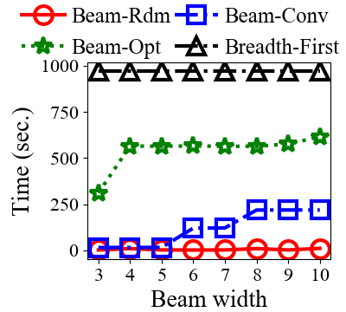
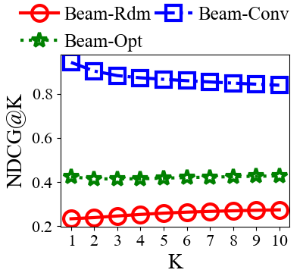
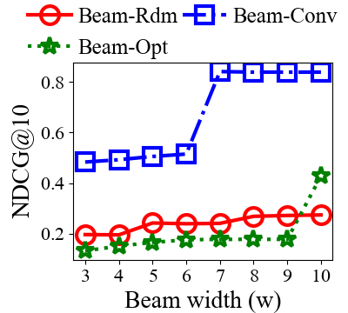
Experiments
WCGoals
Notes:
To evaluate how effective the beam search methods are, we run breadth-first methods to exhaustively numerate all 2-edge patterns, and use NDCG as the metrics.
The figure on the left shows the execution time of beam search methods as well as breadth-first methods. As we can see that Breadth-First method takes most time, while Beam-Rdm takes least time. Beam-Conv and Beam-Opt are in between. The figure in the center shows NDCG@K scores when beam width is 10. As we can see from the figure, Beam-Conv is good at finding highly scored pairs and performs significantly better than other beam search methods. The figure on the right shows NDCG@10 of beam search methods. As we can see from figure, as we increase the beam width, beam search method usually performs better, since the search would have better coverage of the candidates.

Slide 48
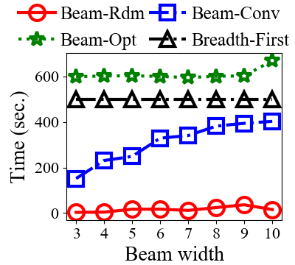
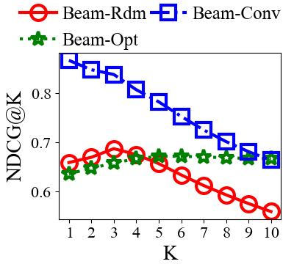
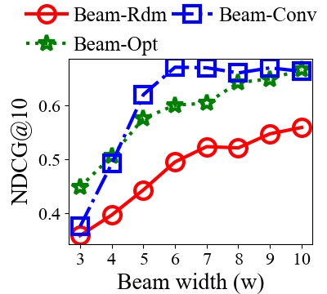
Experiments
Film-Awards
Notes:
Similar experiments have conduct on Film-Awards. In the execution time figure on the left, we can see Beam-Opt even needs more time than Breadth-First. The reason is that beam-opt choose patterns that define large context, which means that it is expensive to evaluate the patterns and as a result, it is expensive to calculate the heuristics. The figure in the center shows that Beam-Conv also outperforms other beam-search methods, especially on finding highly-scored pairs. However, as we can see from the NDCG@10 scores, the performance of Beam-Conv is similar to Beam-Opt. The reason is that, while Beam-Conv is good at finding highly-scored pairs, it may lose the chance to cover pairs that in mid-class.

Slide 49
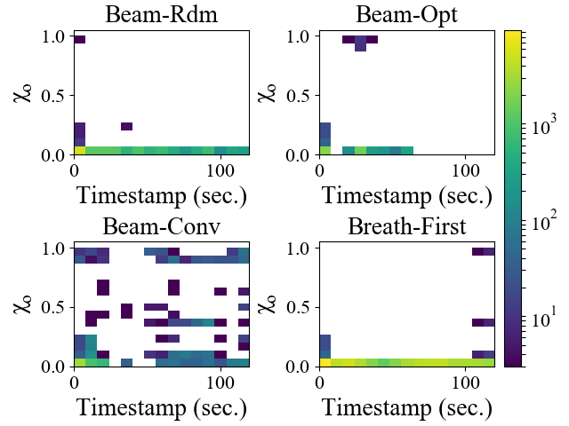
Experiments
Highly-scored
entities
WCGoals
Notes:
The figure shows the heat map of context-subspace pairs of highly-scored 10 entities in graph WCGoals. The x-axis is the time when the context-subspace pair is discovered, and the y-axis is the exceptionality score of the pair.
As we can see from the figure, Beam-Conv discovers more high scored pairs than any other methods, while Beam-Opt performs poorly, as we discussed previously.

Slide 50
Discovering General Prominent Streaks in Sequence Data
TKDD 2014 -- Extension of [Jiang2011KDD]
Notes:
In the next few minutes, I will discuss the prominent streak project in details

Slide 51

Motivation
Japanese gross domestic product increased by 4 percent in annualized terms in the three months through June... The economy has now expanded for six consecutive quarters, the first time it has gone that long without a contraction since the 2005-6 period.
08-13-2017
Notes:
First, let’s look at a recent news of the New York times,

Slide 52
Motivation
Japanese gross domestic product increased by 4 percent in annualized terms in the three months through June... The economy has now expanded for six consecutive quarters, the first time it has gone that long without a contraction since the 2005-6 period.
Length of Streak: 6 quarters
Minimum value: 4%
08-13-2017
Notes:
If one look closer to the news, we may find that the news defines a streak of length 6, and the minimum value of the streak is 4%. And it is the first time it has gone that for about 11 years.
Such examples motivate the discovery of prominent streaks.

Slide 53
Problem Formulation
Dominance Relationship
Streak s1 dominates s2, iff.
s1 is longer than s2, and the value of s1 is greater than or equal to the value of s2; or
s1 is longer than or of the same length as s2, and the value of s1 is greater than the value of s2
S₁ =<[6, 10], 3>
S₂ dominates S₃
S₁ and S₂, S₁ and S₃ do not
dominate each other
S₂ =<[4, 5], 7>
S₃ =<[1, 2], 4>
Notes:
The dominance relationship is defined on the length and the value of the streaks.
Streak s1 dominates s2, if and only if both the length and the value of s1 are better than or equal to s2, and either the length or the value of s1 is better than s2.
Let’s represent a streak by a pair, the first element of the pair is the starting position and the ending position of the streak, the second element is the value of the streak.
As we can see, s2 dominates s3, because s2 is of the same length as s3, but it has a larger value.
Note that s1 and s2, s1 and s3 do not dominate each other, according to the definition.

Slide 54
Problem Formulation
Prominent Streaks [Jiang2011KDD]
Streaks that are not dominated by others.
Extensions [Zhang2014TKDD]
Top-k Prominent Streaks
Multi-Sequence Prominent Streaks
Multi-Dimensional Prominent Streaks
Top-k Multi-Sequence Multi-Dimensional Prominent Streaks

Slide 55
Examples
Top-k Prominent Streaks
Streaks that are not dominated by k or more streaks.
“Golden State fell to 24-1. Its 28-game winning streak, …, came to a halt. The NBA's longest winning streak was 33 by the Los Angeles Lakers in 1971-72.”
Multi-sequence Prominent Streaks
Streaks that are not dominated by any streak in any sequence.
“ Shaquille O‘Neal became the only player in NBA history to have at least 6 points for 771 consecutive games. ”

Slide 56
Examples
Multi-dimensional Prominent Streaks
Data entries in the sequence are multi-dimensional
“ Only player in NBA history to average at least 20 points, 10 rebounds and 5 assists per game for 6 consecutive seasons. (Kevin Garnett) ”
Putting it together (top-k, multi-sequence, multi-dim)
“ The Chicago Bulls legend rattled off seven consecutive triple-doubles … He’d fall second to Wilt Chamberlain’s NBA record of nine straight triple-doubles. ”

Slide 57
Local Prominent Streaks (LPS)
LPS are streaks that are not locally dominated
s₁ dominates s₂ locally, iff.
s₁ dominates s₂, and
s₂ is a sub sequence of s₁
S₁ =<[6, 10], 3>
S₁ dominates S₂ locally
S₁ dominates S₃, but not locally
S₂ =<[6, 9], 3>
S₃ =<[1, 1], 3>
Notes:
First, we introduce the concept of local prominent streaks
Basically, a streak s1 is said to locally dominate streak s2 if and only if s1 dominates s2, and s1 is a super streak of s2

Slide 58
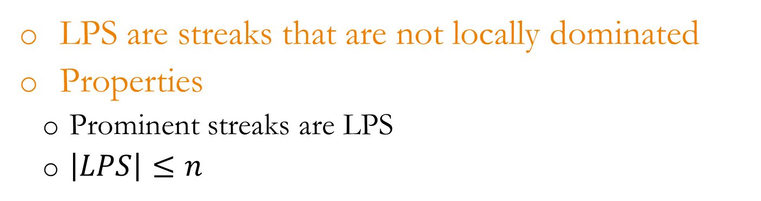
Local Prominent Streaks (LPS)
LPS are streaks that are not locally dominated
Properties
Prominent streaks are LPS
$\left|LPS\right|≤n$
Notes:
There are two nice properties of LPS.
The first is that prominent streaks are local prominent streaks
The second is that the number of LPS is at most the length of the sequence
The two properties make that LPS is a good set of candidates of prominent streaks

Slide 59
Algorithms
Non-Linear LPS
Local Prominent Streaks (LPS)
Streaks are not locally dominated
Compute PS with all the current “LPS”
Current “LPS” may be not LPS
Linear LPS
Compute PS with only LPS
S₁ =<[6, 9], 3>
New value at 10: 4
S₂ =<[6, 10], 3>
Notes:
We developed two algorithms for finding prominent streaks: Non-Linear LPS, and Liner LPS. Both algorithms are based on the concept of Local prominent streaks (LPS), which are the streaks are not locally dominated.
While Non-Linear LPS compute prominent streaks based on all the streaks that may be a local prominent streaks, the Linear LPS algorithm computes prominent streaks with only LPS.

Slide 60
Experiments
Execution time (top-5 prominent streaks, in ms)
Data sets | Length | #PS | Baseline | NLPS | LLPS
Gold | 1074 | 147 | 1884 | 348 | 44
……
SP500 | 10136 | 516 | 7.08x10⁶ | 13700 | 270
……
AOL | 132480 | 250 | >10 hours | 26000 | 798
WC98 | 7603201 | 409 | >10 hours | >10 hours | 13300
Notes:
We have performed experiments on multiple sequence datasets. The table shows a few comparisons of execution time between methods. As we can see from the table, LPS based method can significantly reduce the execution time, which can be attributed to the reduction of the number of candidates.

Slide 61
Experiments
Execution time (multi-sequence, in ms)
Data sets | #sequences | #PS | Baseline | NLPS | LLPS
NBA1 | 1225 | 281 | 3436 | 310 | 292
Wiki | 8 | 14454 | 33537 | 275 | 190
Notes:
We have performed experiments on multiple sequence datasets. The table shows a few comparisons of execution time between methods. As we can see from the table, LPS based method can significantly reduce the execution time, which can be attributed to the reduction of the number of candidates.

Slide 62
Experiments
Execution time (multi-dimensional, in ms)
Data sets | Len | Dim | #PS | Baseline | NLPS | LLPS
Malone | 986 | 6 | 640 | 4575 | 336 | 180
Crashes | 3287 | 5 | 1493 | 1.08x10⁵ | 1113 | 326
AAPL | 6411 | 3 | 2616 | 5.65x10⁵ | 9997 | 557
Notes:
We have performed experiments on multiple sequence datasets. The table shows a few comparisons of execution time between methods. As we can see from the table, LPS based method can significantly reduce the execution time, which can be attributed to the reduction of the number of candidates.

Slide 63
Experiments
Execution time (top-k, multi-sequence, multi-dim)
Data sets | NBA2 | Baseline | 9.41x10⁷
#Sequence | 1185 | NLPS | 2.98x10⁶
Average length | 290 | LLPS | 8.76x10⁵
Dimension | 6
#PS | 10867
Notes:
We have performed experiments on multiple sequence datasets. The table shows a few comparisons of execution time between methods. As we can see from the table, LPS based method can significantly reduce the execution time, which can be attributed to the reduction of the number of candidates.

Slide 64
Fact-finding/fact-checking systems
Fact Watcher
ClaimBuster
Maverick

Slide 65
Data in, Fact out: Automated Monitoring of Facts by FactWatcher
VLDB 2014 Best Demonstration Award
Notes:
In the following, I will present a system, FactWatcher, that was developed based on three different fact-finding projects: prominent streak, situational facts, and one-of-the-few.

Slide 66
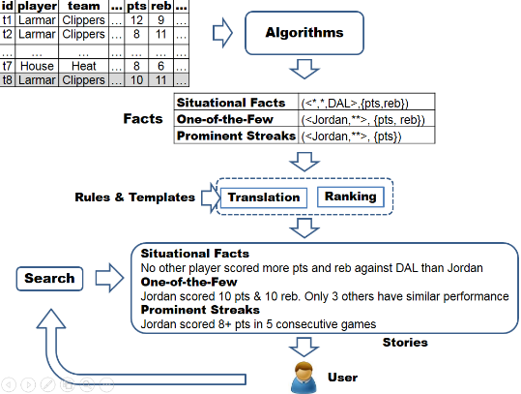
Framework
Situational Fact [Sultana2014ICDE]
One-of-the-Few [Wu2012KDD]
Prominent Streaks [Jiang2011KDD,
Zhang2014TKDD]
Notes:
This figures show the framework of FactWatcher. The input of the system is an append-only table, we then apply three different algorithms to discover three different types of facts: situational facts, one-of-the-few, and prominent streaks. The facts are ranked using a unified metrics and translated to natural language sentences using a set of predefined rules and templates.

Slide 67
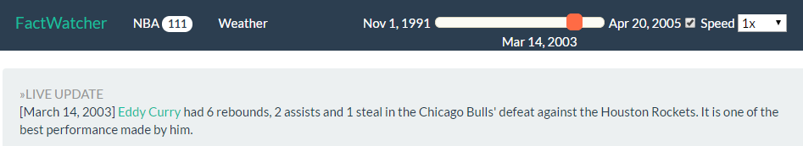
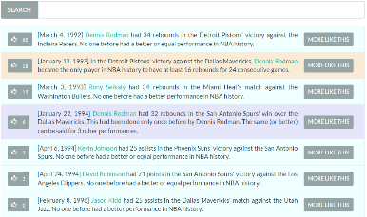

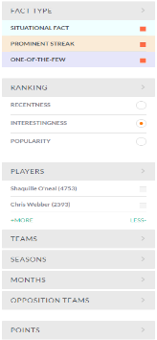

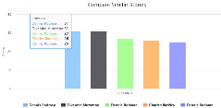
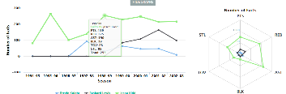
(1) Live Update
(2) Stories
(3) Exploration Facets
(4) Player
Profile
(5) Similar Stories
(6) Player Comparison
Notes:
We demonstrate the system using two datasets, NBA, and weather. The main interface consists of story panel, exploration facets, and live update panel. Users can read and search stories discovered by the system, and use the exploration facets to adjust what and how the stories to be shown. The live update panel simulates that we have new records appending to the table.

Slide 68
ClaimBuster: The First-ever End-to-end Fact-checking System
VLDB 2017
Notes:
In the next few minutes, I will present an end-to-end fact-checking system, claimbuster.

Slide 69
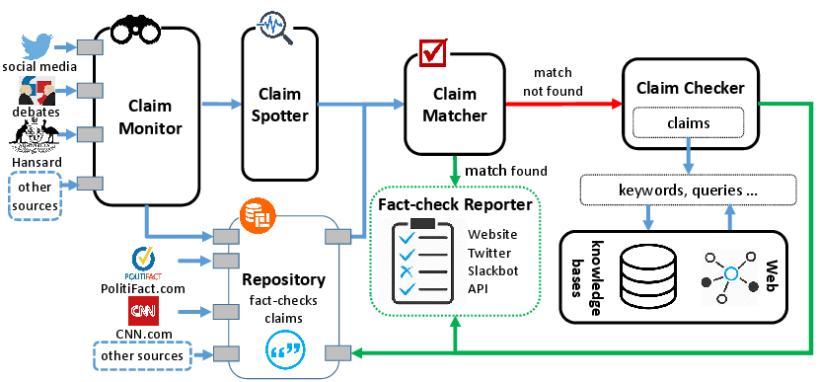
Framework
Claim Monitor [Arslan2015]
Claim Spotter [Hassan2015CIKM]
Notes:
The figure in the slides show the framework of claimbuster. The system consists of 5 components.
Claim monitor interfaces with various data sources with claimbuster, such as social media, broadcasted tv programs, and website
The claim spotter identifies checkworthy factual claims in verbose text from the data sources.
The claim matcher finds existing well-researched fact-checks that are closely rated or identical to the discovered claims.
When a matching fact-check cannot be found, the claim checker queries external knowledge bases and the Web to vet the factual claims.
The fact-check reporter complies the evidence from the claim matcher and the claim checker, and presents fact-check reports to users through various channels, such as the project web site, its twitter account, a Slackbot, and a public API.

Slide 70
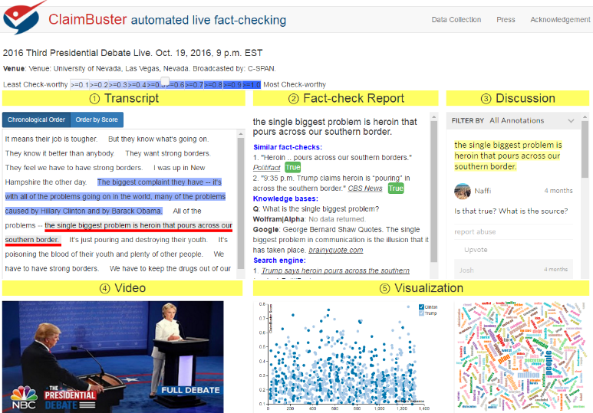

Notes:
This figure shows the user interface when it is applied on a debate. There are five panels
Transcript panels shows the transcript of the debate, each sentence is shown with different shade of blue indicating the check-worthiness of the sentence.
When user selects a sentence in the transcript, the fact-check report of the sentence is shown in the upper middle panel. Users can also discuss the sentence using the upper right discussion panel.
The video of the debate is shown at the bottom left when it is available. Each sentence spoken by the debate participants will be shown with a score assigned by claim spotter.
The bottom right panel shows visualization of transcripts. The first chart is the claim spotter scores of sentences. And the second chart is the word cloud of the transcript.

Slide 71
Maverick: Discover Exceptional Facts
from Knowledge Graphs
On-going work
Notes:
In the next few minutes, I will present an end-to-end fact-checking system, claimbuster.

Slide 72






Framework
entity
entity
Front-end
Middleware
Back-end
Facts of entity
Facts of entity
Fact-Repository
Knowledge Graph

Slide 73
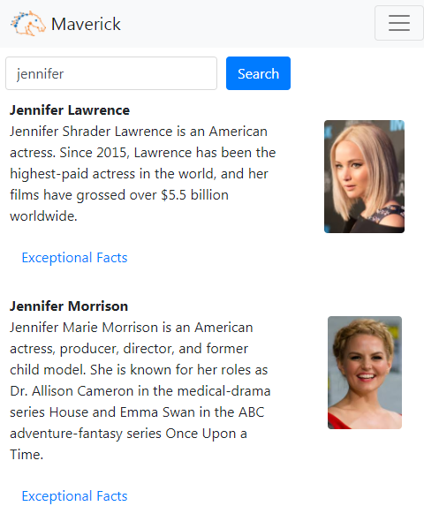
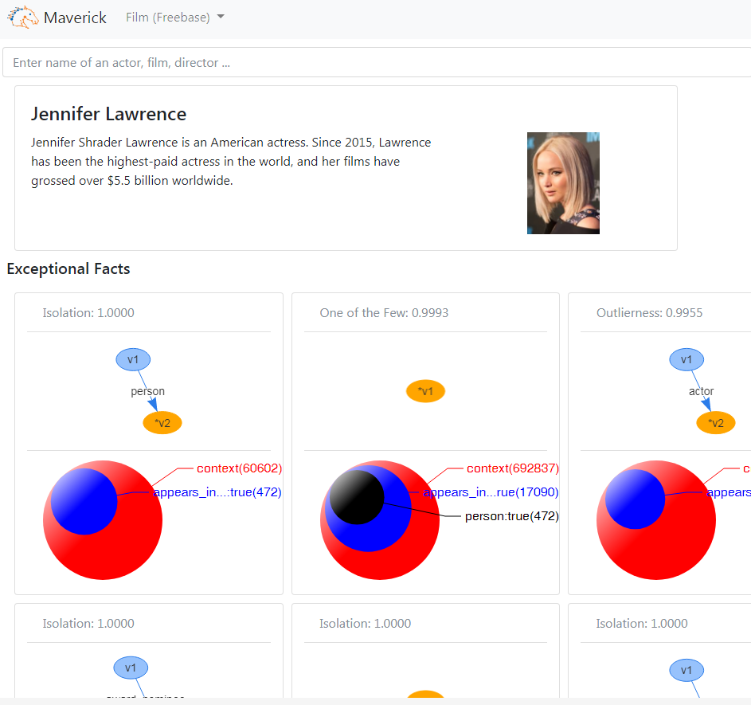
Fact portal
Search portal
Entity profile
The area of circles are
in logarithmic scale
Fact cards

Slide 74
Summary
Frameworks/Algorithms
Exceptional Facts
Prominent Streaks
Systems
FactWatcher
ClaimBuster
Maverick

Slide 75
Dissertation Plan & Progress

Slide 76
Dissertation Plan
Faster and effective heuristics
The current Convergent heuristics is computationally intensive.
Possible solution
Improve the efficiency of pattern evaluation
including rewriting queries, and switching to other graph databases if necessary;
Instead of computing the exact sizes of contexts, we may estimate the context sizes.
Goals:
Apply a faster heuristic on a 10 times larger dataset than OscarWinner
Film-Award: 5M+ nodes, 10M+ edges
Journal extension of the current SIGMOD submission of Maverick is ready for submission.
Expected Defense Date
Fall 2017

Slide 77
Q/A

Slide 78
Thank you!

Slide 79

Case Study
The Goal(20292) is the only own goal in Brazil’s World Cup history.
Subspace
Context
$$\{(awared−to, →)\}$$

Slide 80
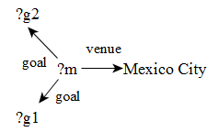
Case Study
The Goal(23464) is the only goal awarded to Paraguay, among all the goals scored in a match which was hosted in Mexico City and had at least two goals.
Subspace
Context
$$\{(awared−to, →)\}$$

Slide 81


Case Study
Among the films produced in the United States, The Lord of the Rings: The Return of the King is one of the only 7 films that are also produced in New Zealand.
Subspace
Context
$$\{(country, →)\}$$

Slide 82

Case Study
The crew FilmCrew(7674) by Paul J. Franklin is the only one crew of role Computer Animation.
Subspace
Context
$$\{(film−crew−role, →)\}$$

Slide 83
Case Study
The crew FilmCrew(7674) by Paul J. Franklin is the only one crew of role Computer Animation.
Computer Animator
Subspace
Context
$$\{(film−crew−role, →)\}$$

Slide 84
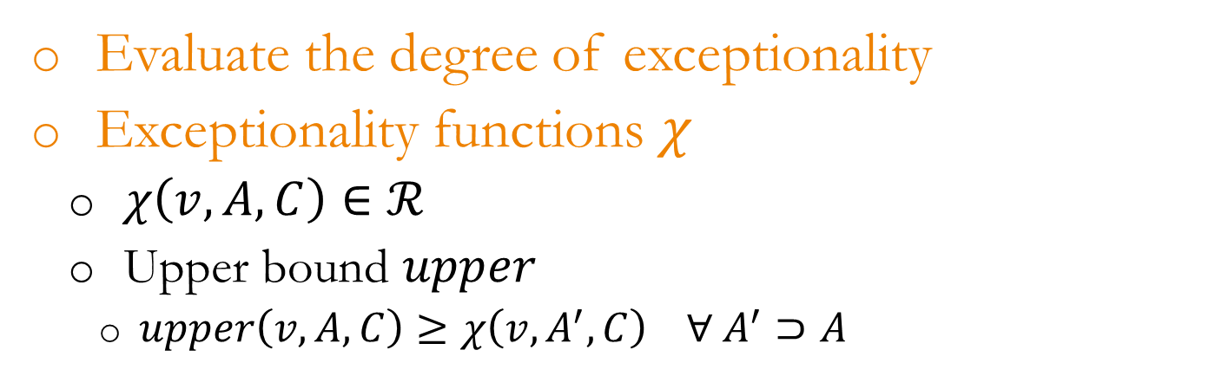
Exceptionality Evaluator (EE)
Evaluate the degree of exceptionality
Exceptionality functions $χ$
$χ\left(v, A, C\right)∈ℛ$
Upper bound $upper$
$upper\left(v, A, C\right)≥χ\left(v, A^{′}, C\right) ∀ A^{′}⊃A$
Notes:
As a result, we assume that the given exceptionality function has an upper bound for a given subspace, such that the score of the entity with regard to any superset of the subspace does not exceed the upper bound

